Slide 1
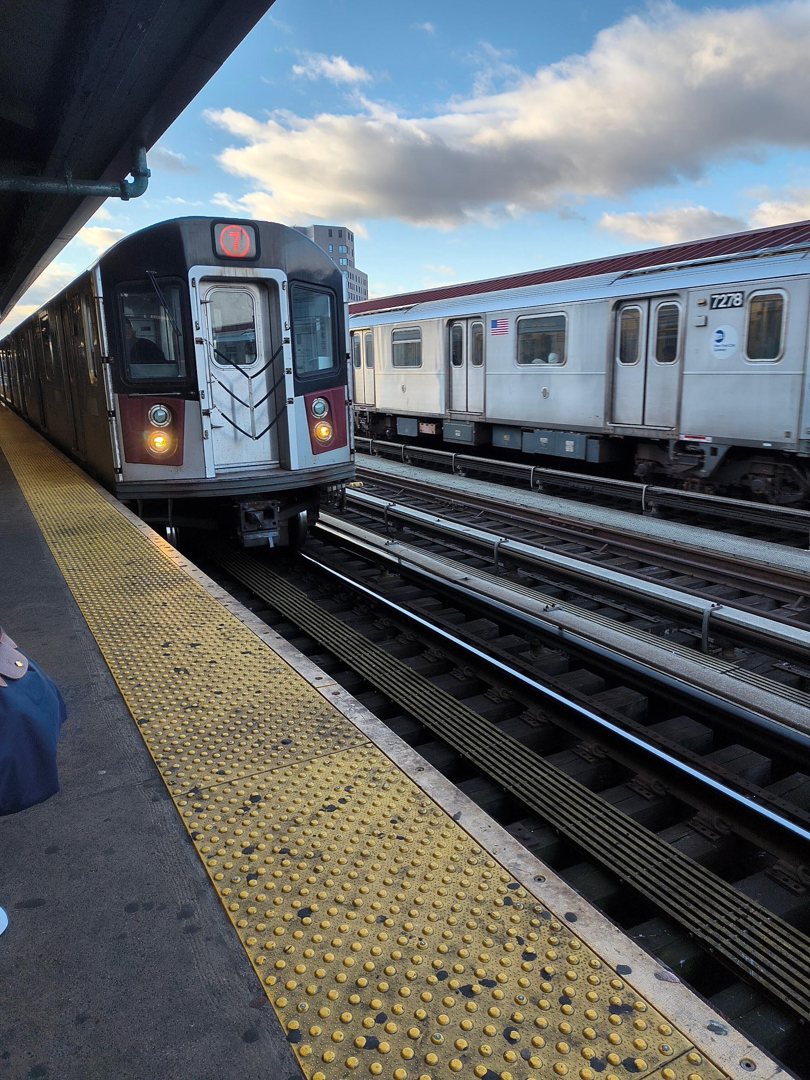
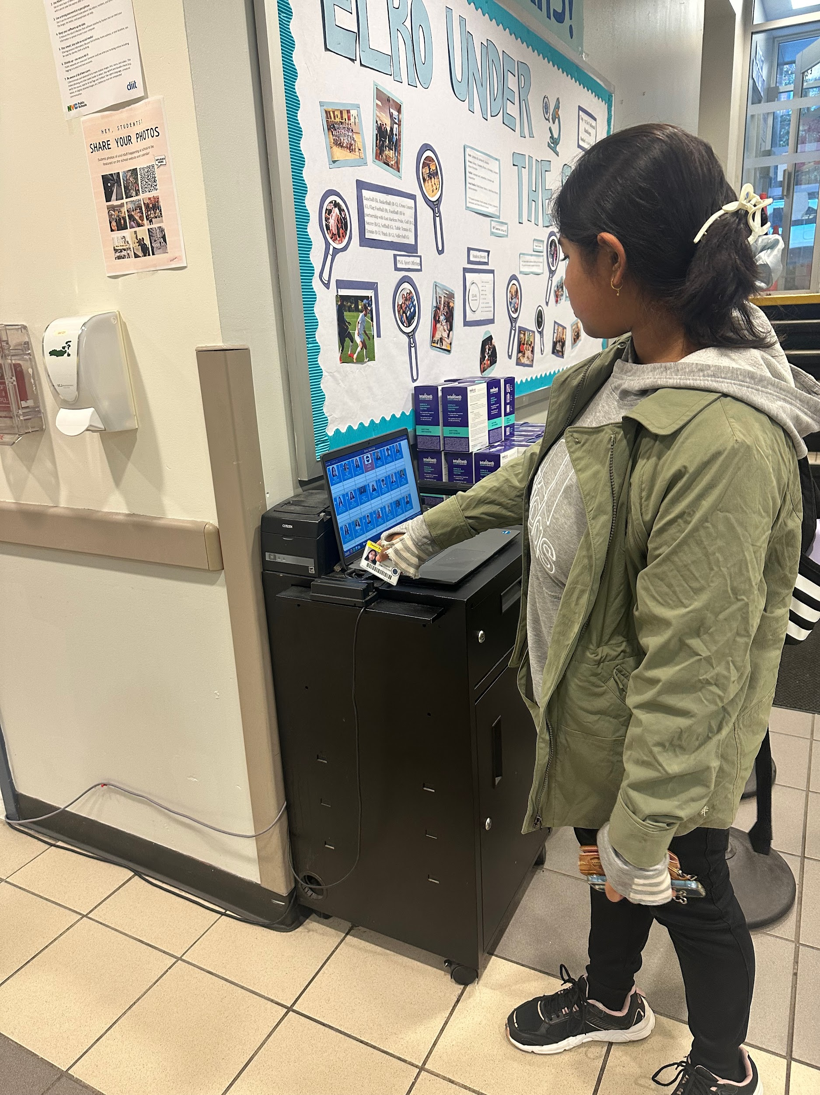
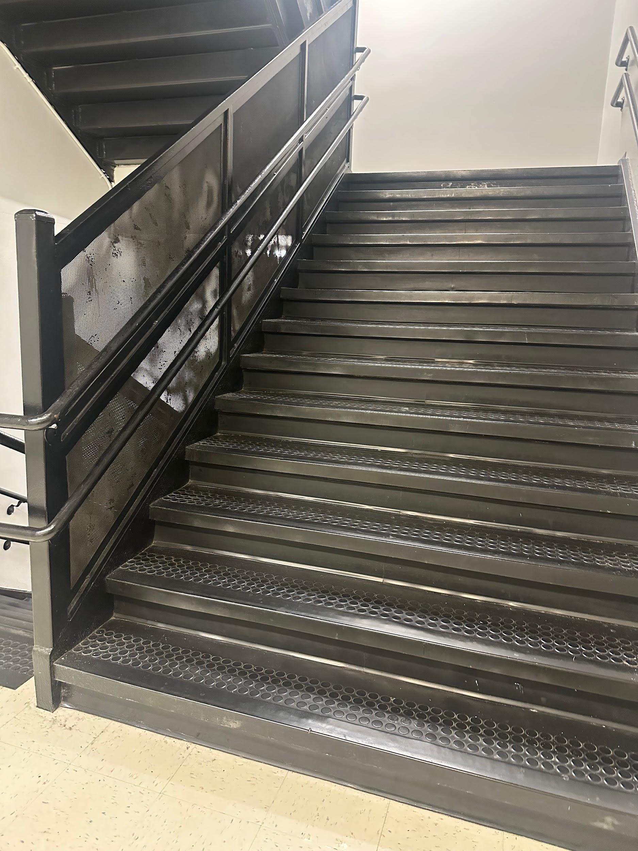
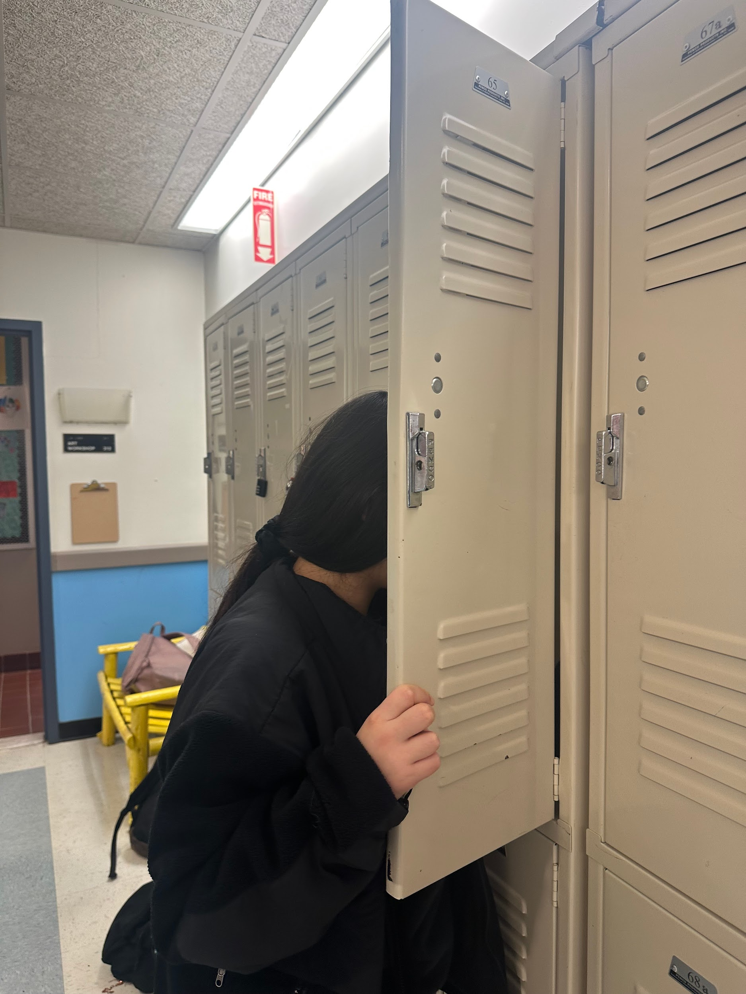
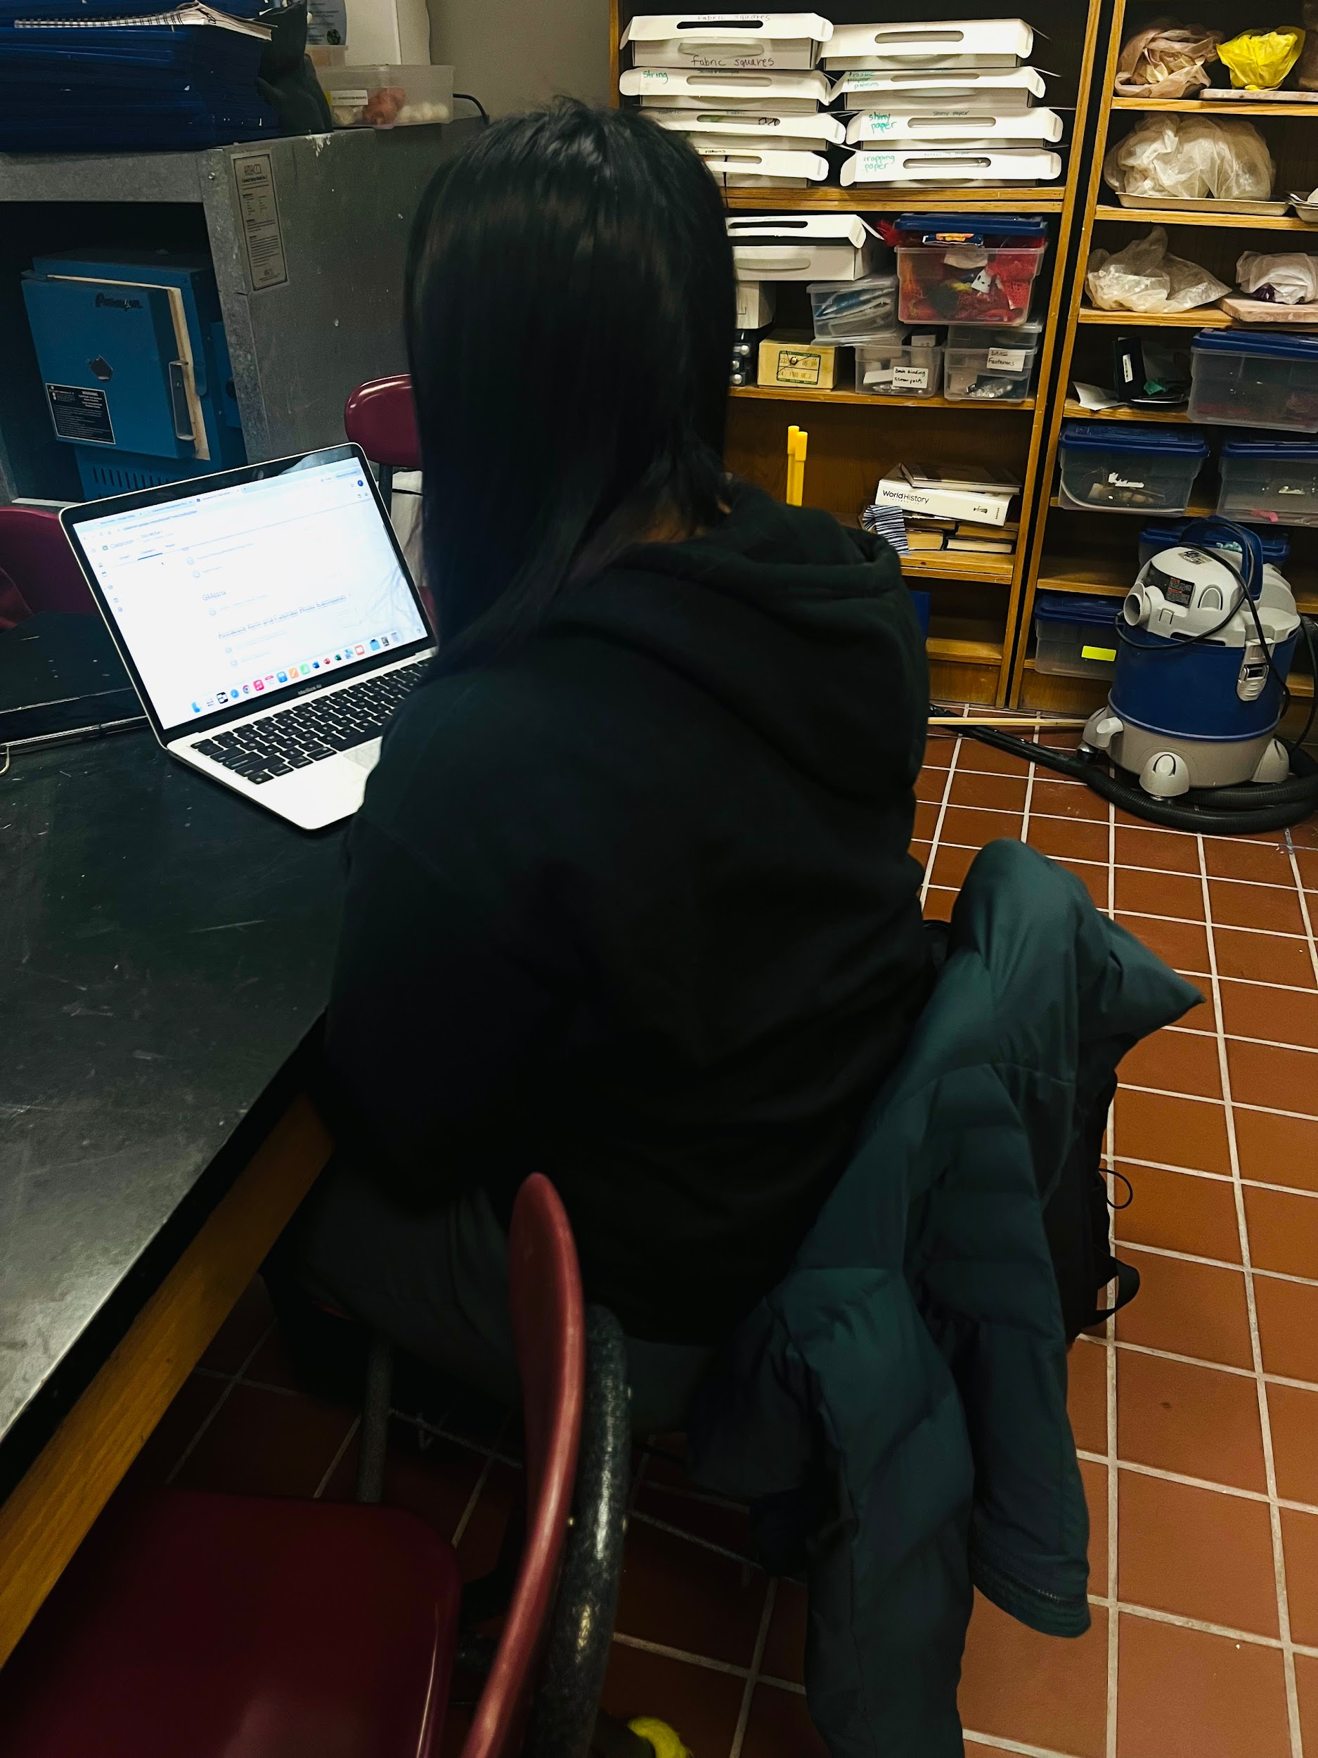
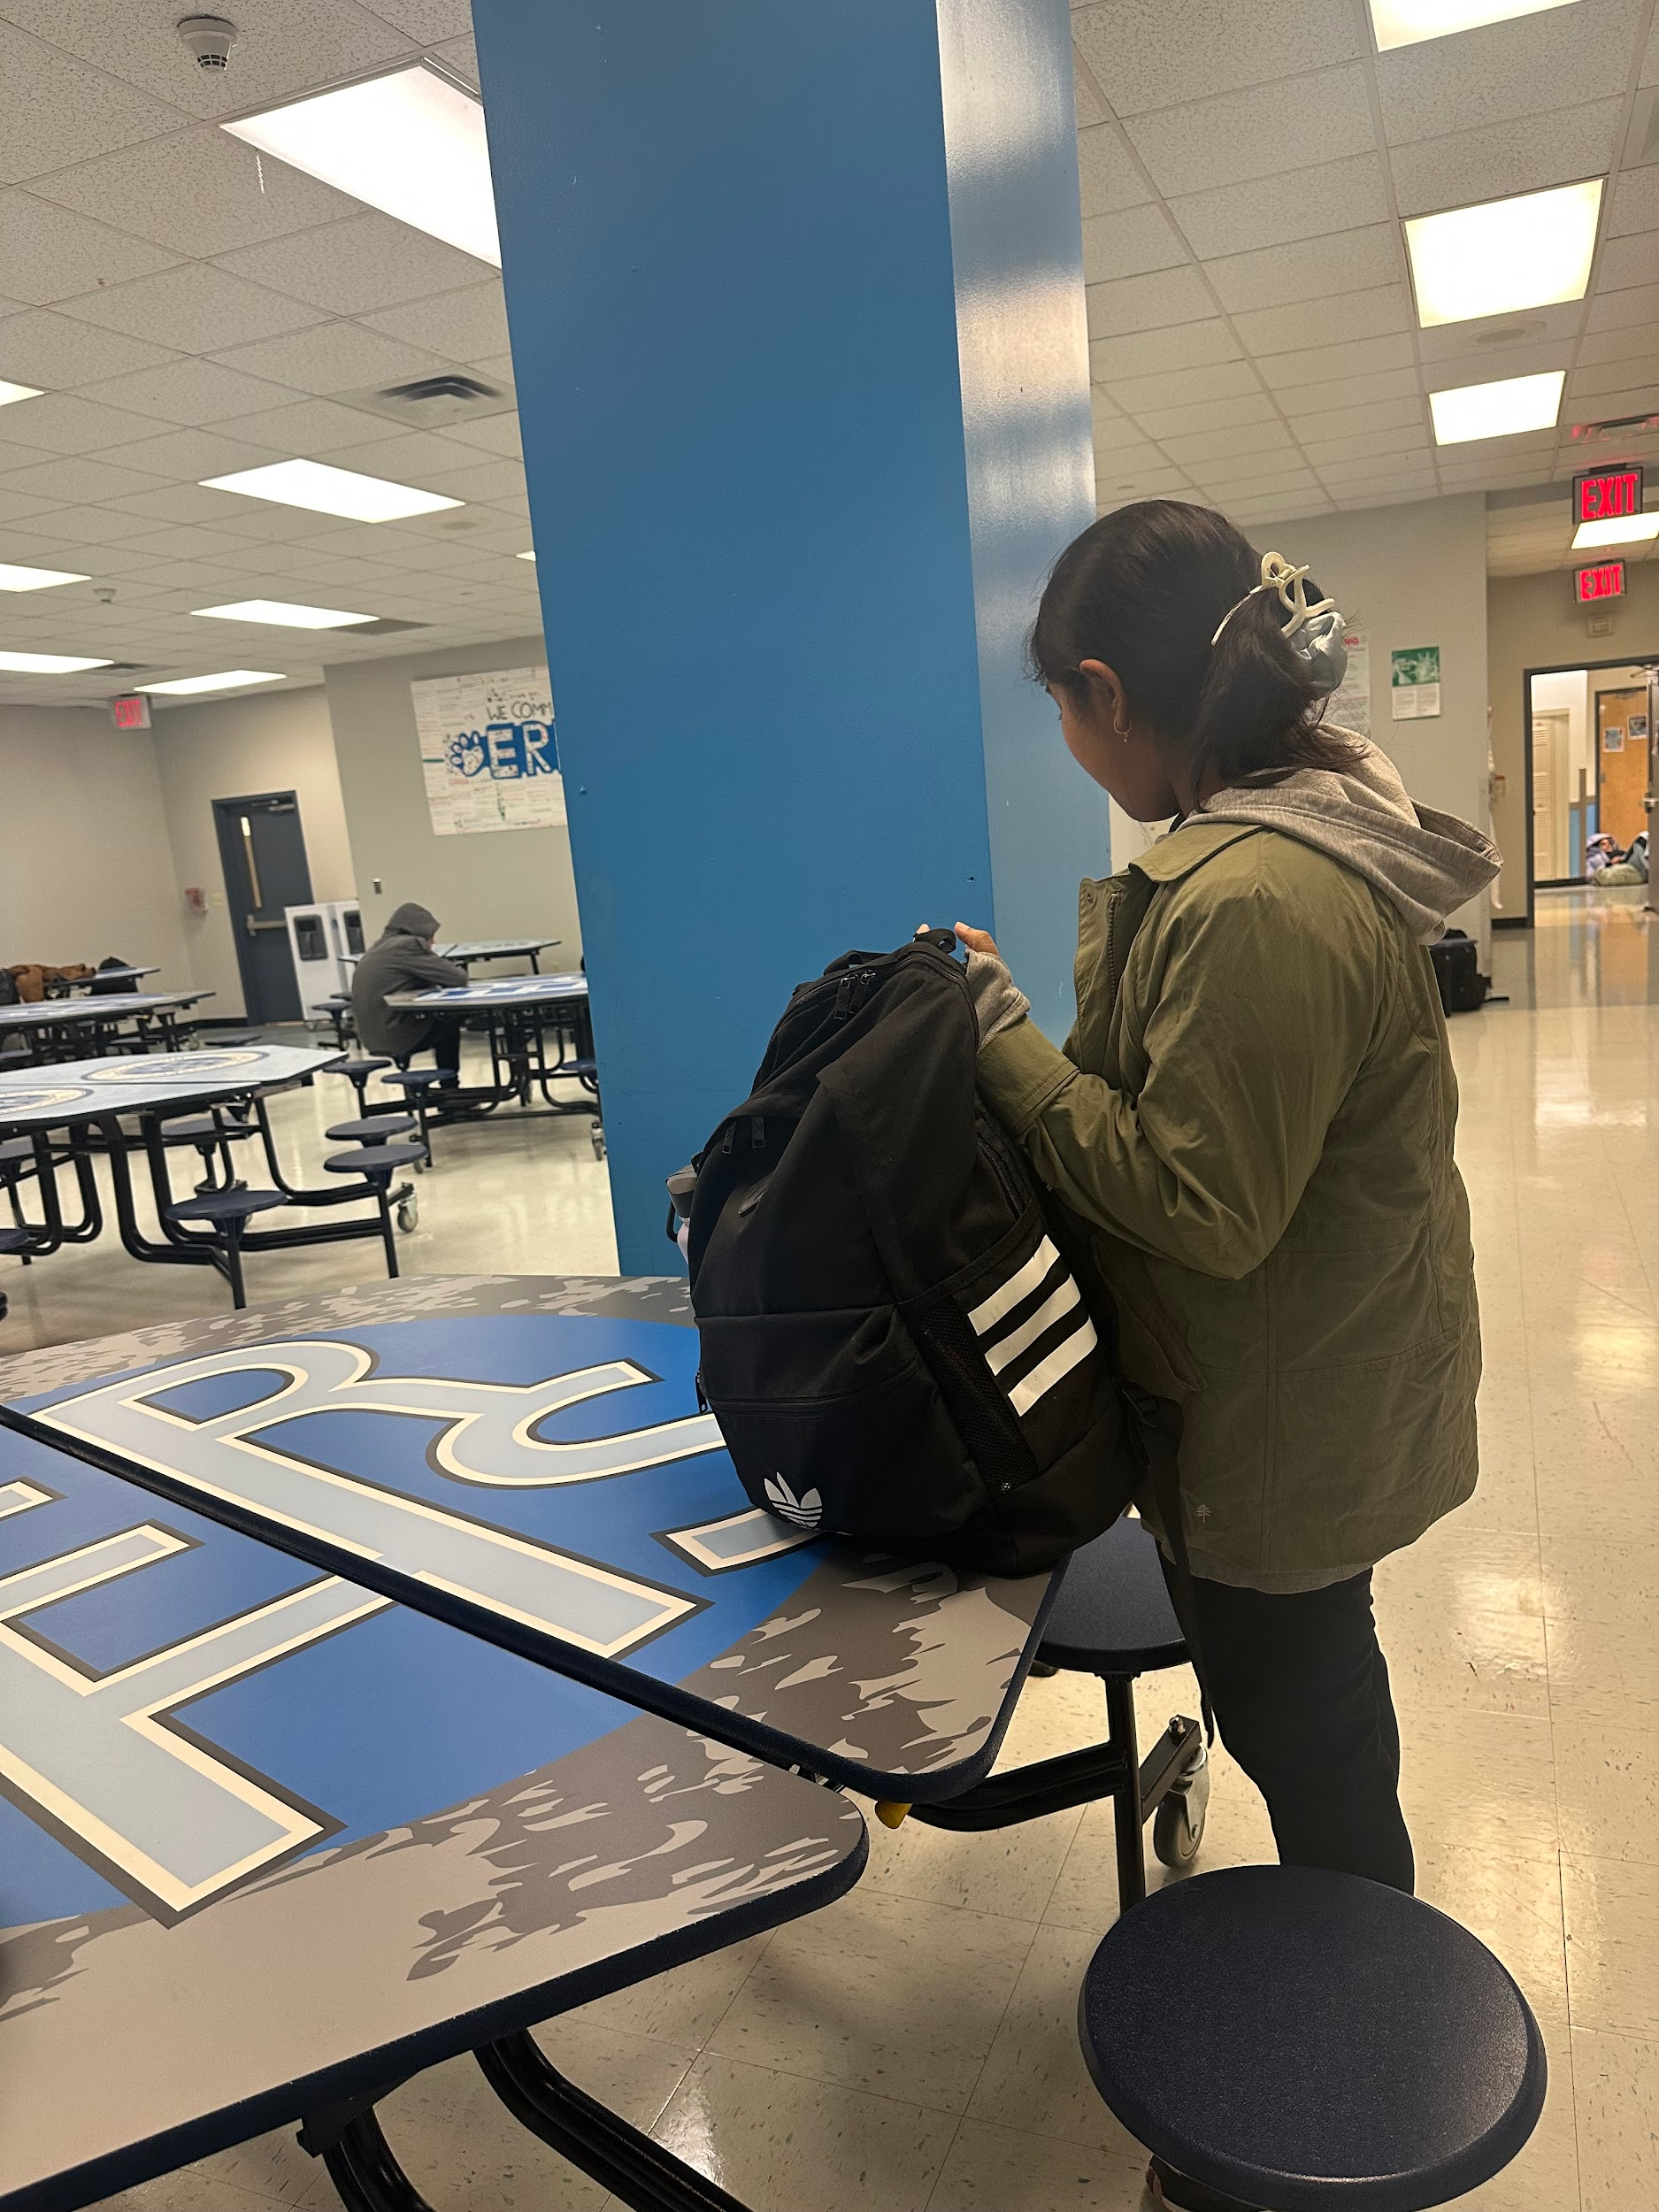
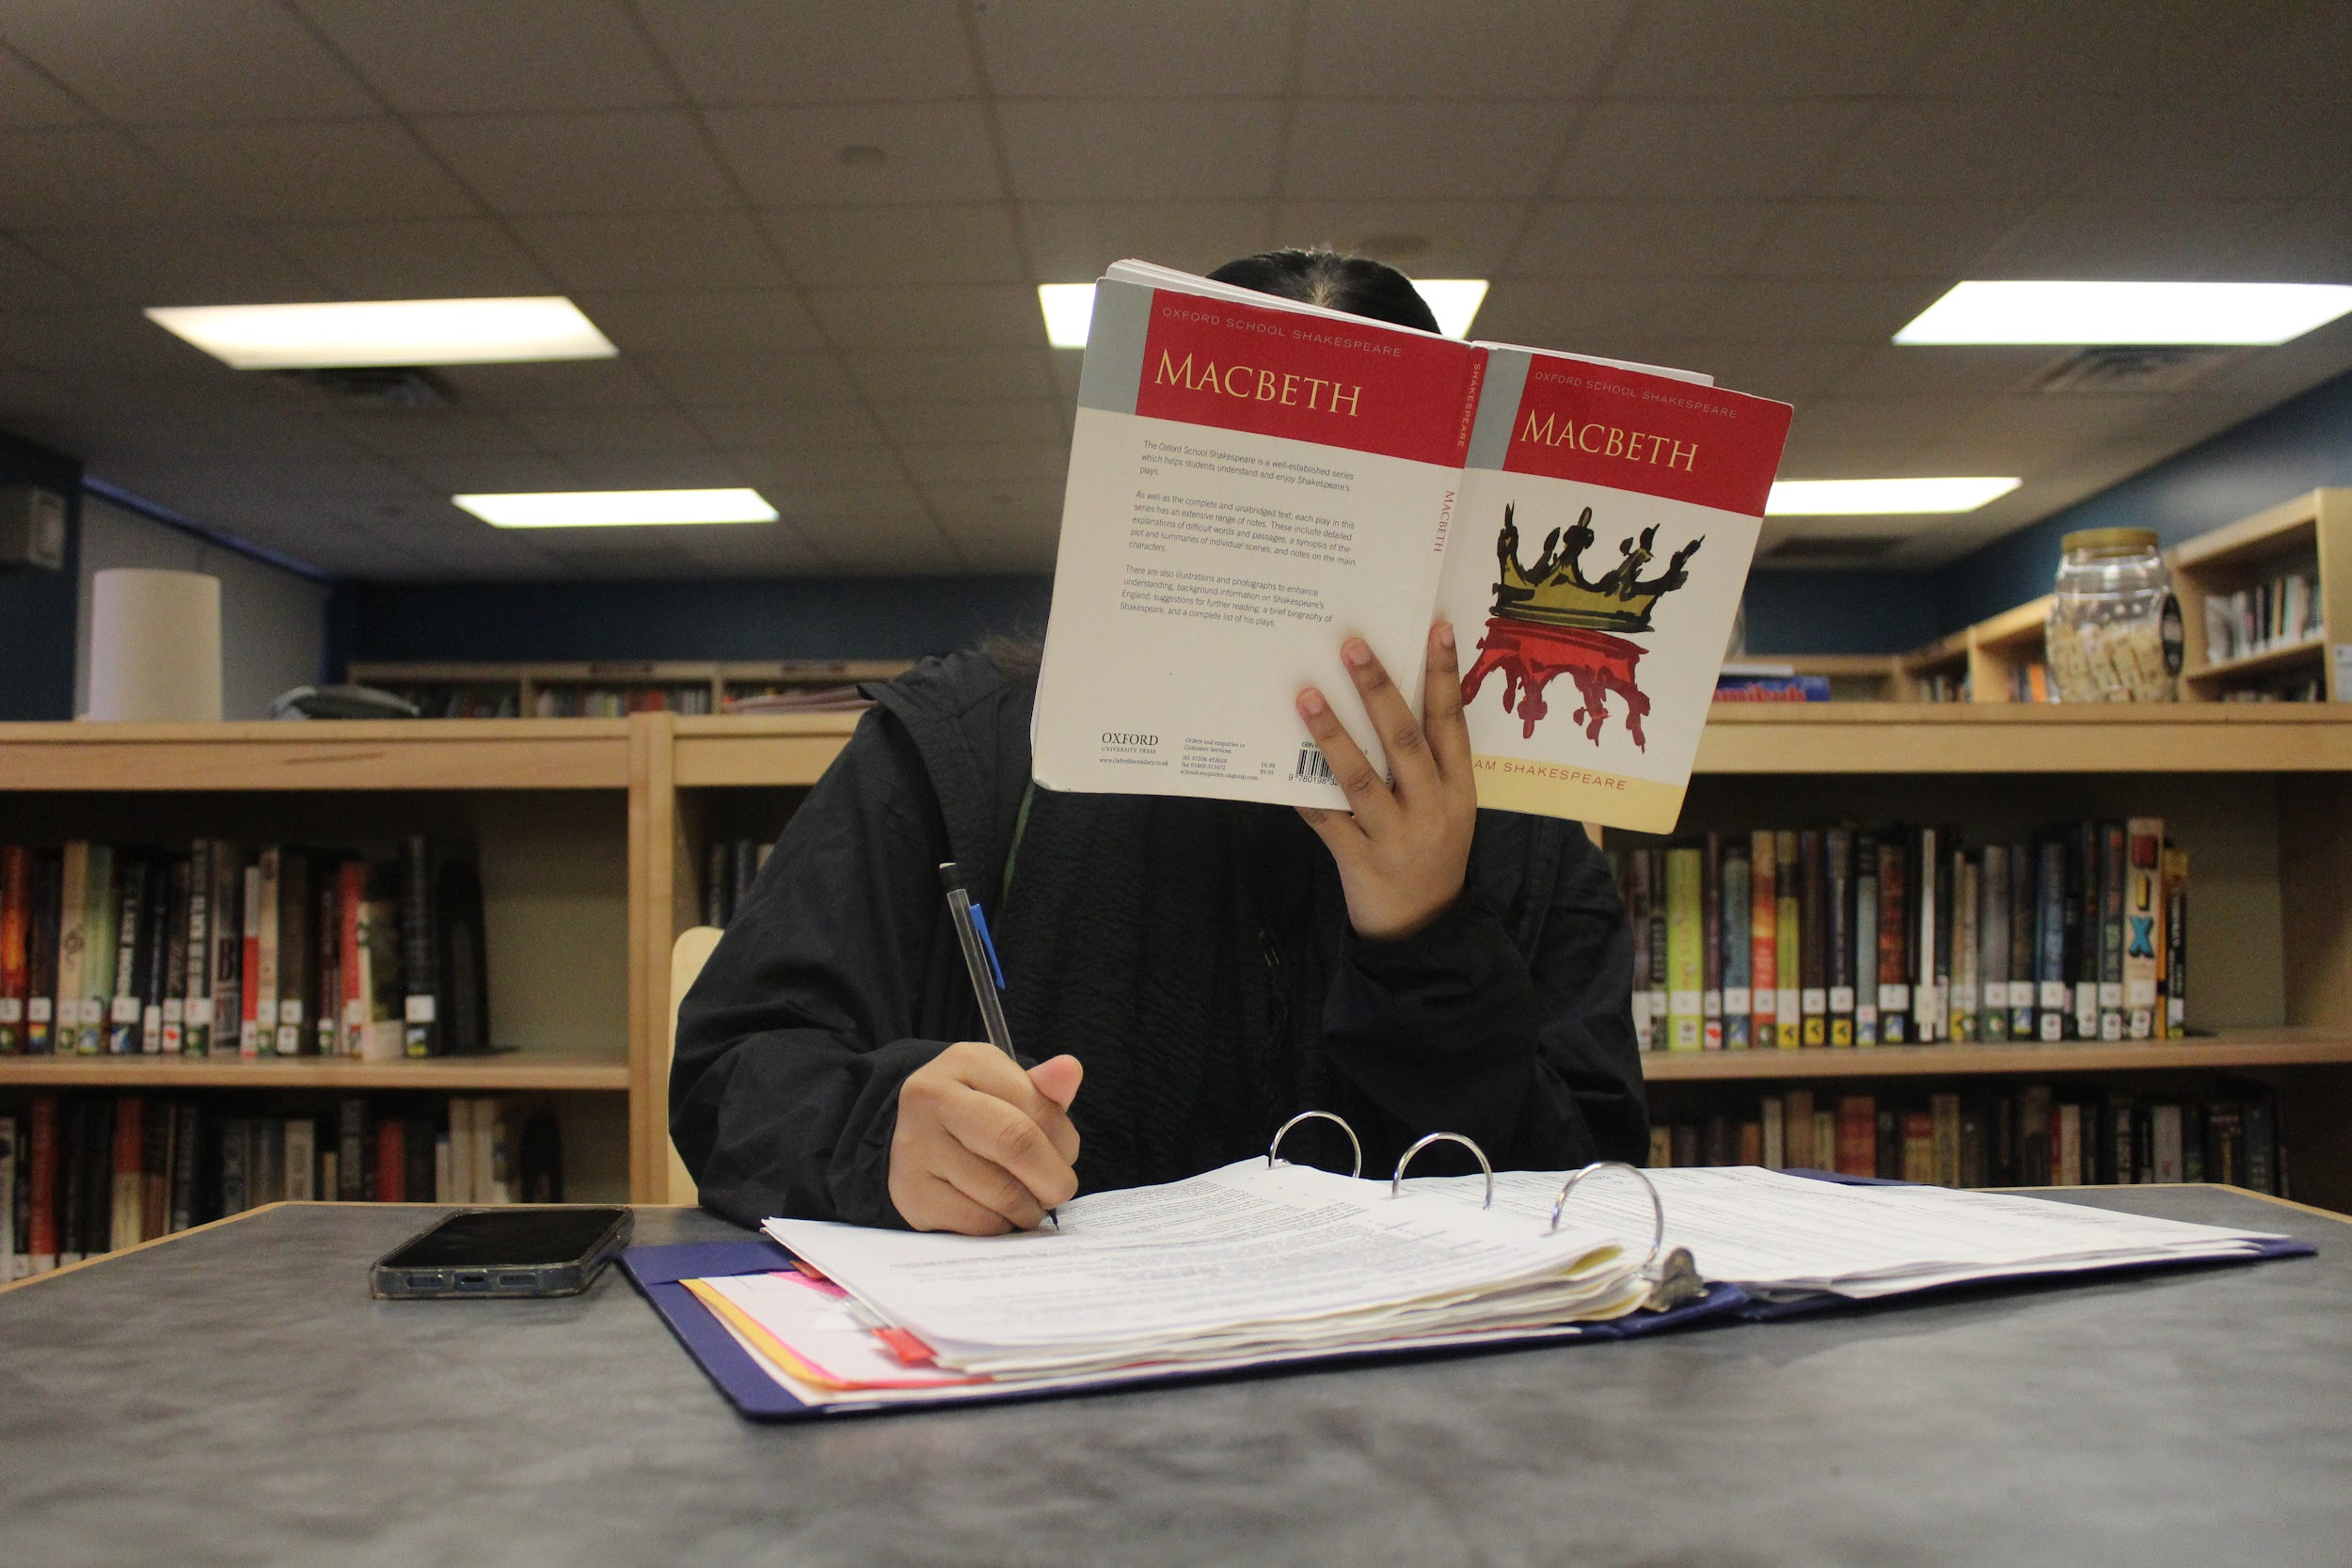
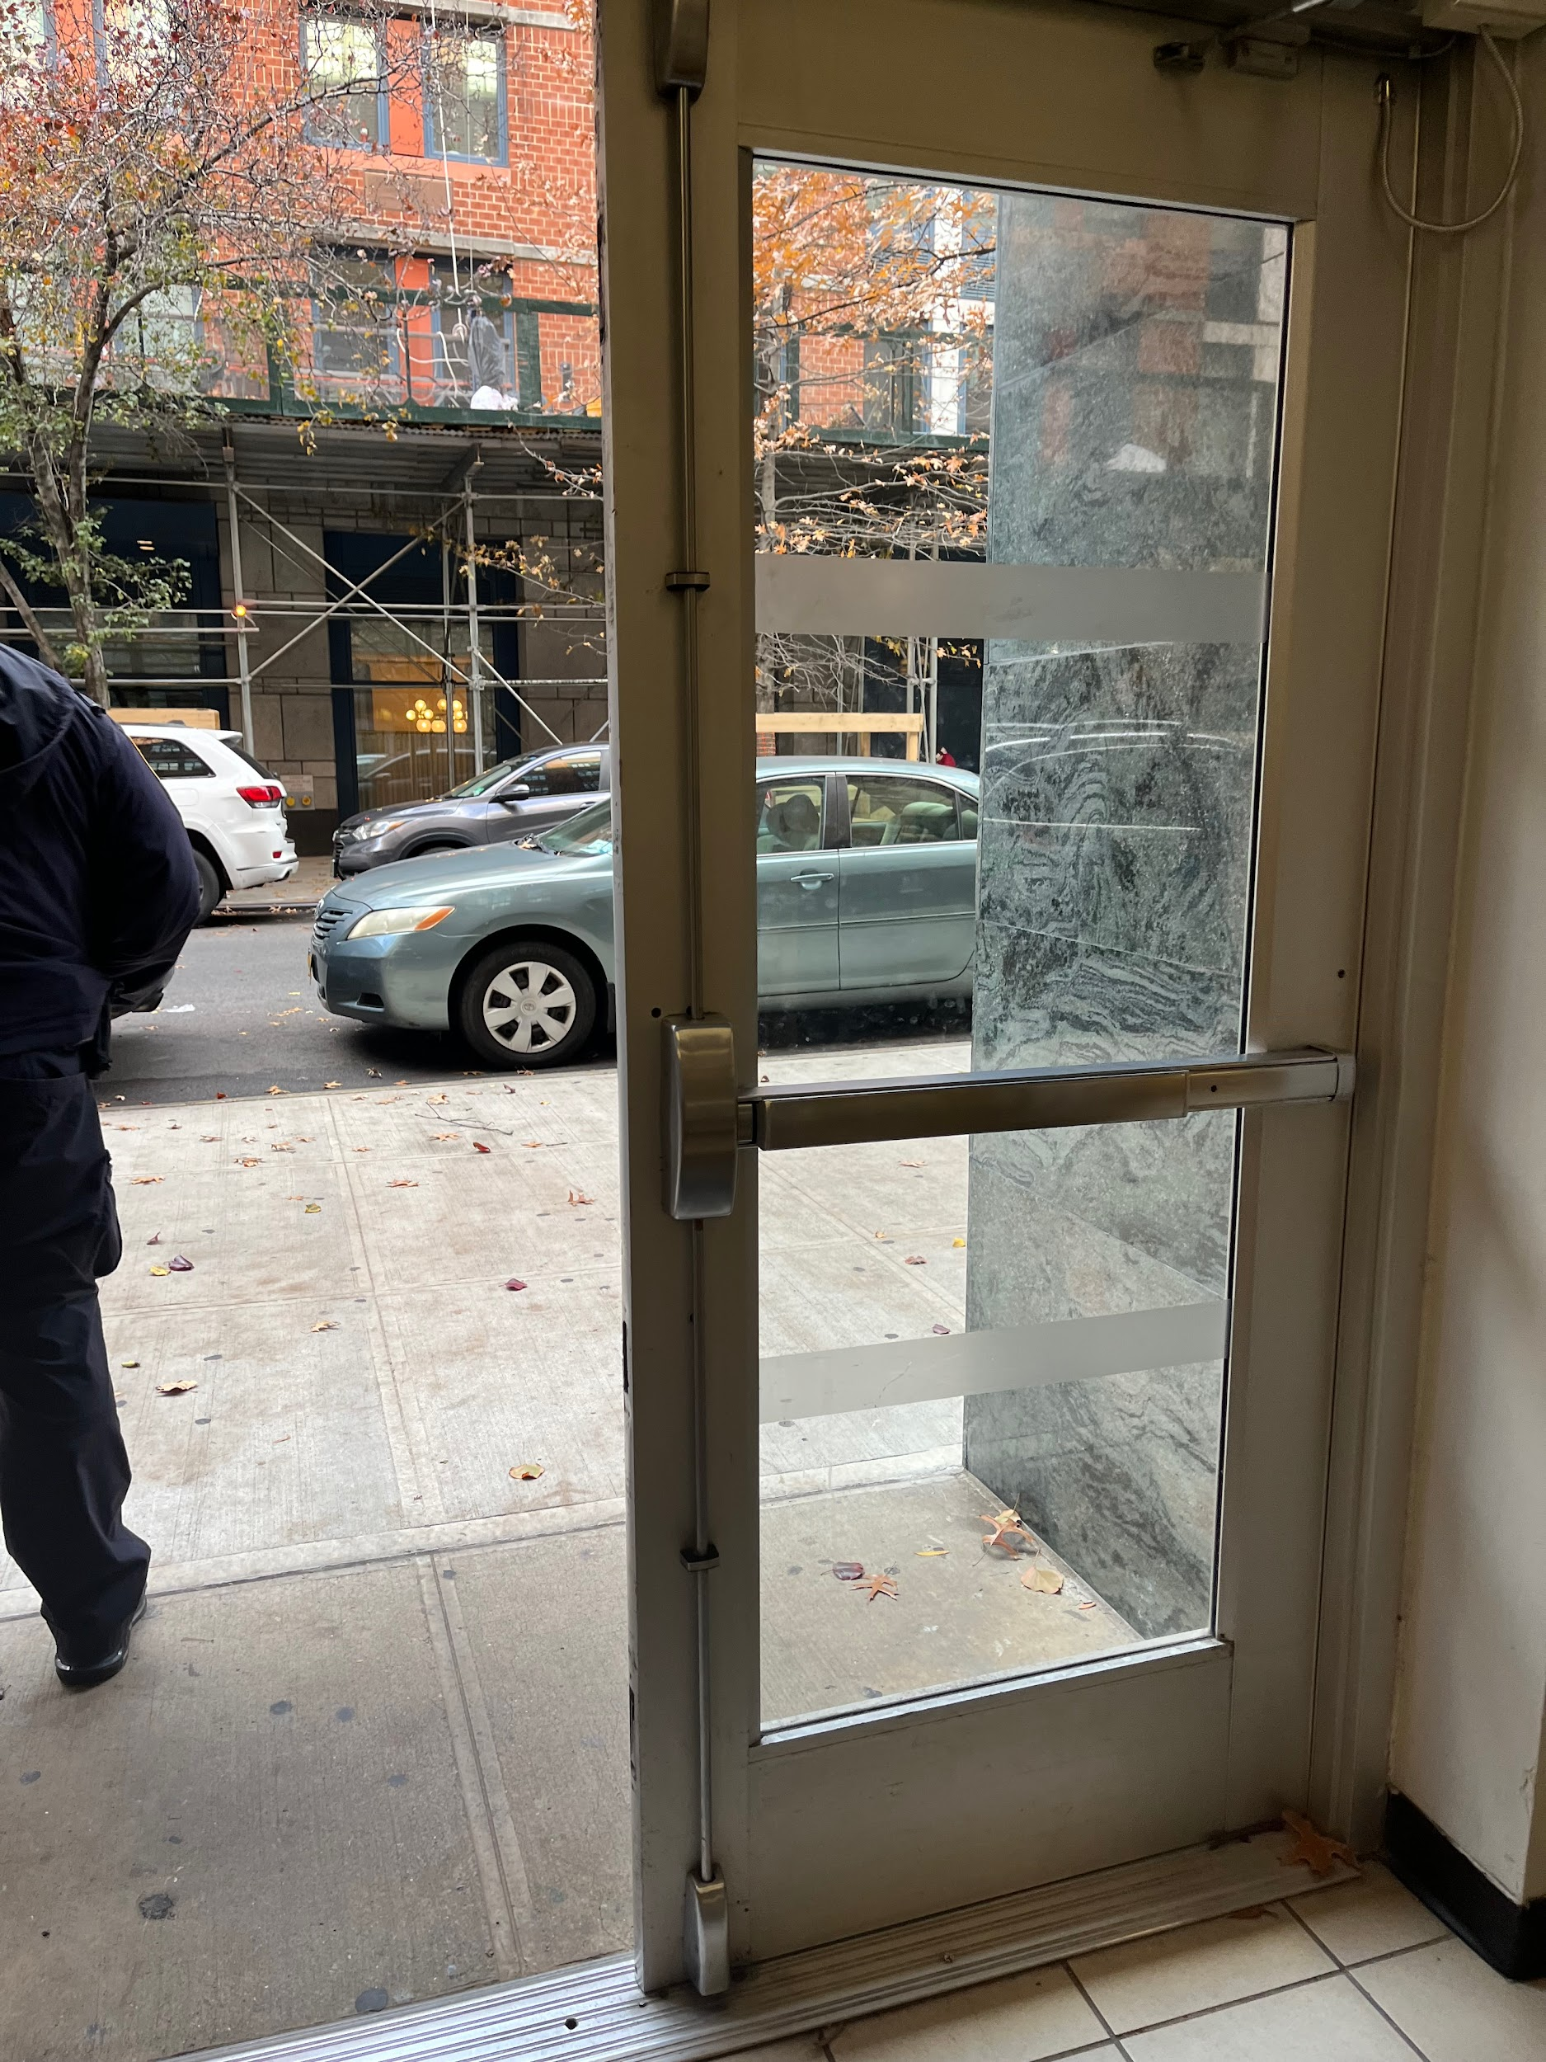
SCHOOL LIFE
By: Farjana, Isabella, Alejandra

Slide 2
This picture was taken at the train station during the morning. I used the rule of thirds and a high aperture setting to emphasize that the day has just begun. This picture gives context to our story by presenting the commute for a high school student.

Slide 3

This picture was taken at the entrance of Eleanor Roosevelt High School at the start of a school day by Isabella. I used the rule of thirds for this picture by taking this picture at the right third of the image so the subject isn’t placed in the center of the photo. This picture gives context to our story because this picture shows a student checking into school by scanning in their ID to be marked present for the day.

Slide 4

This picture was taken in the staircase of Eleanor Roosevelt High School by Isabella. I used leading lines to take this picture so the stairs could be the main focus of the picture. This picture gives context to our story because it shows how teachers and students get around to different parts of the school building.

Slide 5

This picture was taken on the 2nd floor of Eleanor Roosevelt High School right outside of the art room. This picture gives context to our story because students usually go to their lockers throughout the school day to put things in and out of their locker.

Slide 6
This picture was taken during class in digital media. The picture gives context to the story by showing a student doing classwork which is a daily task in school. In this picture, the exposure was turned down making the photo less bright to see what was going on in the laptop.

Slide 7

This picture was taken in the cafeteria of Eleanor Roosevelt High School by Isabella. I used the rule of thirds to take this picture by taking this picture at the right third of the image so the subject isn’t placed at the center of the photo. This picture gives context to our story because students usually eat lunch or hangout in the cafeteria at some point of the school day.

Slide 8
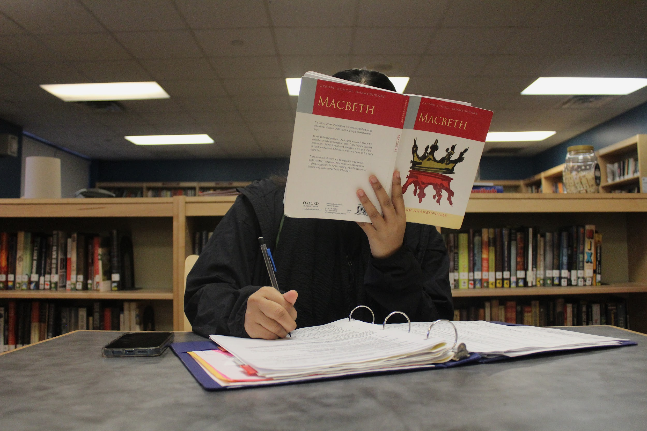
This picture was taken at the library during the morning. I used a low aperture setting to express a focused mood. This picture gives context to the story by demonstrating that students can be found in the library studying for their classes.

Slide 9
This picture was taken at the end of the school day during the afternoon. This picture gives context to the story, school ending with the students POV about to exit the building doors. The rule of thirds is used in this photo with the door on the right to really show where students go out every time.

Slide 10
Artist Statement
For our story board project we used 8 pictures in total to represent the daily life of a high school student. The theme of the story shown by the photos is that Aspects of life can continue and stop in a repetitive cycle. School is very much an aspect of life since it takes up majority of most people’s daily lives from the years of elementary and middle school and now to high school. All of these pictures were taken at different parts of our school that we usually see at least once a day during the week. These are parts of the school our group usually goes to on a daily basis. We arranged the pictures in our slides from the beginning of the school day to the end of the school day. The first picture that we used to represent the start of the school day was how a high school student could commute to school. The last picture that we used to represent the end of the school day was a high school student about to leave the school to go home. Our group had a lot of fun during this project and we enjoyed the story we choose. We all liked being able to take pictures for this project!

